Slide 1
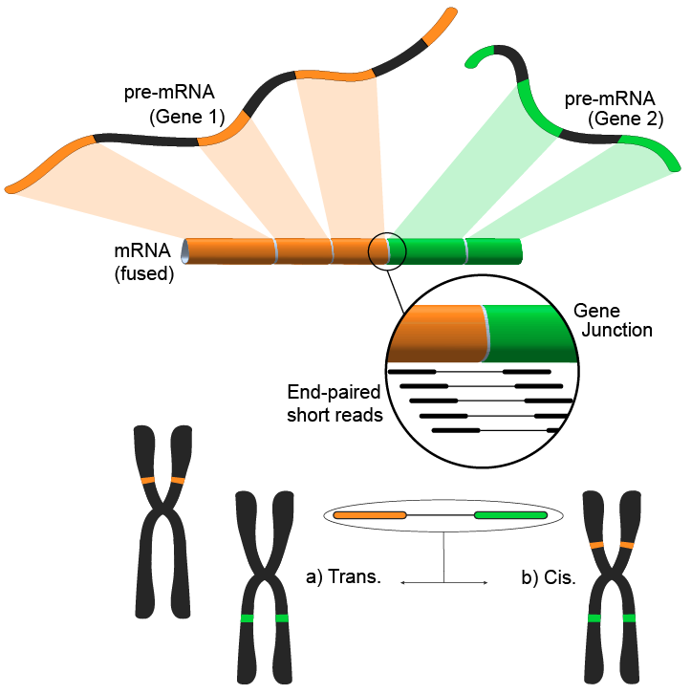
Gene Fusion Discovery
Broad Cancer Program Bootcamp: Fusion Transcript Discovery
Brian Haas
May 9, 2018
Brian:
bhaas@broadinstitute.org
https://github.com/NCIP/Trinity_CTAT/wiki
(Liberal use of material from Andrew McPherson:
andrew.mcpherson@gmail.com
http://compbio.bccrc.ca
http://compbio.cs.sfu.ca
Indicated w/ awm)

Slide 2
Learning Objectives of Module
Explore impact of gene fusions in cancer
Learn about types of evidence for gene fusions
Understanding of the available detection methods/tools
Identify common sources of false positives
Assess a gene fusion’s potential function
awm

Slide 3
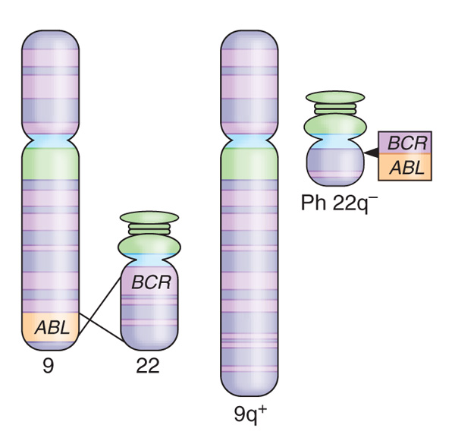
Definition of a Gene Fusion
Novel gene formed by fusion of two distinct wild type genes
In Cancer: produced by somatic genome rearrangements
Lydon, 2009
awm
Notes:
BCR-ABL in Chronic myelogenous leukemia
BCR-ABL one of the first discovered somatic changes
Discovered in Philaelphia 1960 by Peter Nowell, David Hungerford

Slide 4
Diagnostics and Therapeutics Involving Oncogenic Fusion Transcripts in Cancer
BCR-ABL1 (Philadelphia chromosome)
Chronic Mylogenous Leukemia (CML) cases (95% of cases)
Treatable with tyrosine kinase inhibitors
TMPRSS2-ERG
prostate cancers (50% of cases)
EML4-ALK
Non small cell lung carcinoma (4% of cases)
anaplastic lymphoma kinase (ALK) inhibitors improve patient outcome
DNAJB1-PRKACA
fibrolamellar hepatocellular carcinoma (FL-HCC), 100% of cases, but a rare cancer.
FGFR3-TACC3
found in 8.3% of glioblastoma patients
Notes:
Fusion transcripts can be potent drivers of cancer, and there are a small number of well-known oncogenic fusion transcripts that are considered hallmarks of specific tumor types.
Some of the fusions are considered actionable in that they can be treated with certain drugs.
BCR-ABL is the best well known cancer fusion, and it can be treated very effectively with tyrosine kinase inhibitors.
Here are just a few more notable examples:
TMPRSS2—ERG is found in about half of all prostate cancer cases.
EML4-ALK found in a small percent of non small cell lung carcinoma samples, but this is notable because if it’s diagnosed it can be treated with kinase inhibitors and improve patient outcome.
And there are others that in some cases represent a defining feature of that cancer type, or are found at higher proportions within a given cancer type.
There’s strong interest in being able to identify known fusions for diagnostic and treatment purposes, but also to identify new ones that may be playing important roles in disease and to serve as new targets for drug discovery.

Slide 5
Evidence Gene Fusions are Initiators of Carcinogenesis
Correlate with cancer phenotype
Successful treatment reduces/eradicates fusion products
Gene fusions produce neoplastic disorders in mouse models
Silencing fusion transcripts reverses tumorigenesis
awm

Slide 6

How Can Fusions Drive Cancer?
Activate Tumor Oncogene
Deactivate Tumor Suppressor
TMTOWTDI
?

Slide 7
Examples of Fusions With Understood Cancer-driving Mechanisms
BCR—ABL1 in chronic myelogenous leukemia
EWS—FLI1 in Ewings sarcoma
SS18—SSX in synovial sarcoma
TMPRSS2-[ERG/ETV1] in prostate cancer
IGH-MYC in Burkitt’s lymphoma
MYB-NFIB in adenoid cystic carcinomas
LACTB2-NCOA2 in colorectal cancer
MYB-QKI in angiocentric glioma

Slide 8
Classification of Gene Fusion Consequences
Creation of a fusion protein: constitutive kinase
(ex. 1) BCR-ABL1 fusion in Chronic Myelogenous Leukemia
ABL1
Tyrosine kinase
BCR
BCR-ABL1
Mitelman, 2007
Fusion protein is a constitutively active kinase signaling proliferation
awm
Notes:
BCR: unknown gene fusion, tyrosine kinase and GTPase function
ABL1: tyrosine kinase implicated in cell differentiation, cell division, cell adhesion, and stress response

Slide 9
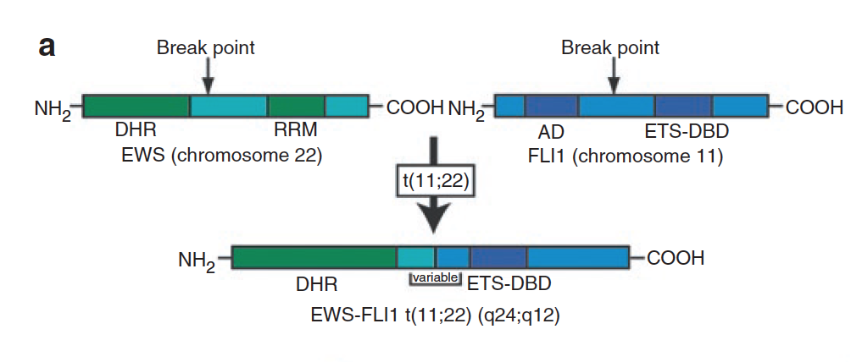
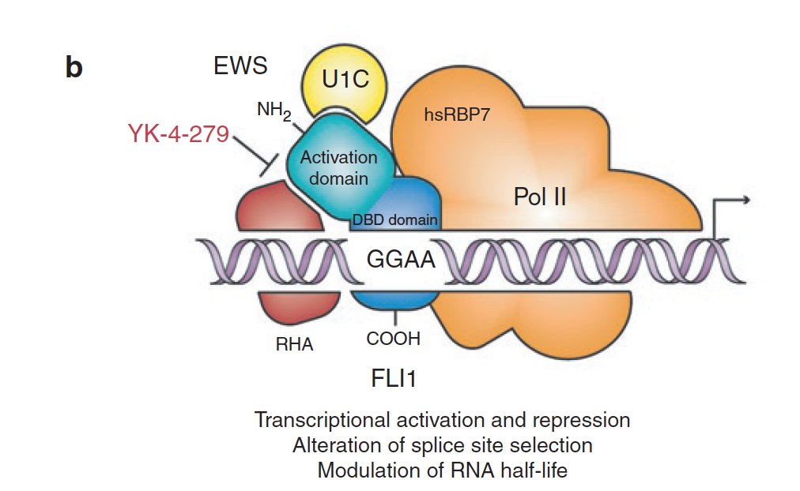
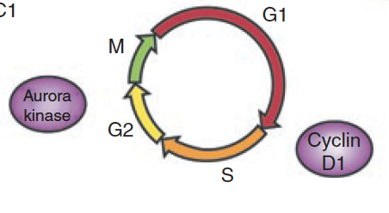
Classification of Gene Fusion Consequences
Creation of a fusion protein: novel Tx factor
(ex. 2) EWS—FLI1 in Ewings Sarcoma
EWS: RNA-binding protein and Tx activator
FLI1: ETS-family Tx factor
Functional Fusion Protein
Molecular Mechanism: Aberrant Transcription Factor Inducing Cell Cycle Activation
Up-regulation of
Aurora kinase and Cyclin D1
Anderson et al., Pediatric Research, 2012
Notes:
EWSR1: This gene encodes a multifunctional protein that is involved in various cellular processes, including gene expression, cell signaling, and RNA processing and transport. The protein includes an N-terminal transcriptional activation domain and a C-terminal RNA-binding domain. Chromosomal translocations between this gene and various genes encoding transcription factors result in the production of chimeric proteins that are involved in tumorigenesis. These chimeric proteins usually consist of the N-terminal transcriptional activation domain of this protein fused to the C-terminal DNA-binding domain of the transcription factor protein. Mutations in this gene, specifically a t(11;22)(q24;q12) translocation, are known to cause Ewing sarcoma as well as neuroectodermal and various other tumors. Alternative splicing of this gene results in multiple transcript variants. Related pseudogenes have been identified on chromosomes 1 and 14. [provided by RefSeq, Jul 2009]

Slide 10
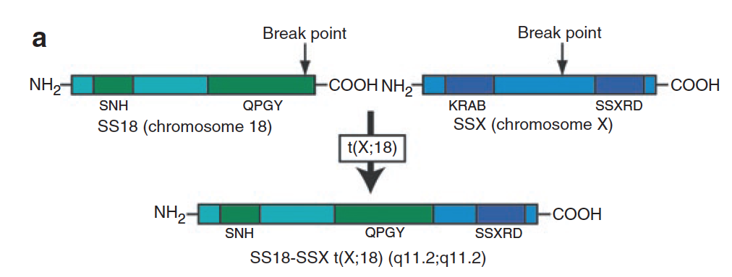
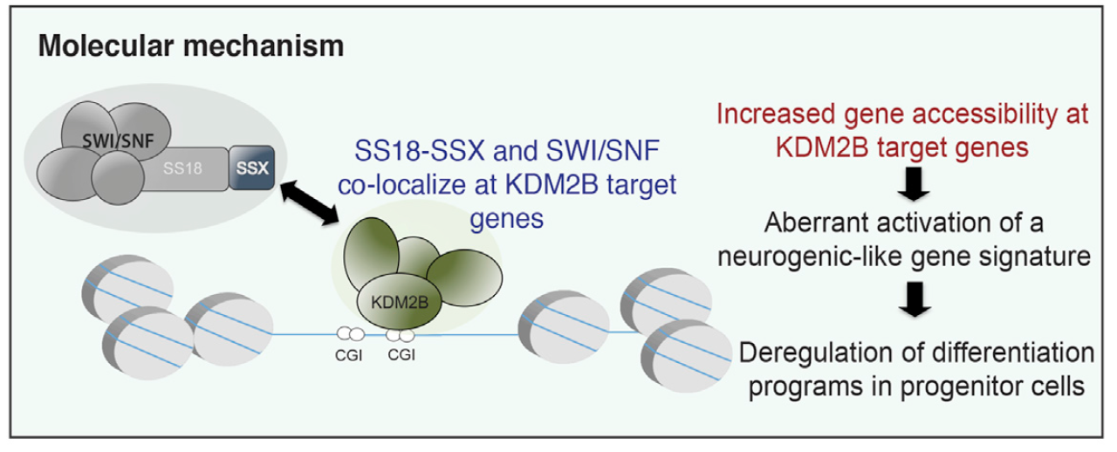
Classification of Gene Fusion Consequences
Creation of a fusion protein: induces chromatin remodeling
(ex. 3) SS18—SSX in Synovial Sarcoma
SS18: subunit of SWI/SNF chromatin remodeling complex
SSX: Tx factor
Functional Fusion Protein
Anderson et al., Pediatric Research, 2012
Chromatin remodeling -> Cellular Proliferation
Banito et al., Cancer Cell, 2018
Notes:
Banito et al. show that SS18-SSX fusions
characteristic of synovial sarcoma
associate with KDM2B-PRC1.1, a noncanonical
polycomb repressive
complex 1, to aberrantly activate the
expression of developmentally regulated
transcription factors that are normally
targets of polycomb-mediated gene
repression.
https://www.cell.com/cancer-cell/abstract/S1535-6108(18)30018-7
Synovial sarcoma is an aggressive cancer invariably associated with a chromosomal translocation involving genes encoding the SWI-SNF complex component SS18 and an SSX (SSX1 or SSX2) transcriptional repressor. Using functional genomics, we identify KDM2B, a histone demethylase and component of a non-canonical polycomb repressive complex 1 (PRC1.1), as selectively required for sustaining synovial sarcoma cell transformation. SS18-SSX1 physically interacts with PRC1.1 and co-associates with SWI/SNF and KDM2B complexes on unmethylated CpG islands. Via KDM2B, SS18-SSX1 binds and aberrantly activates expression of developmentally regulated genes otherwise targets of polycomb-mediated repression, which is restored upon KDM2B depletion, leading to irreversible mesenchymal differentiation. Thus, SS18-SSX1 deregulates developmental programs to drive transformation by hijacking a transcriptional repressive complex to aberrantly activate gene expression.
SS18 is a stable subunit of SWI/SNF nucleosome remodeling complexes, but in synovial sarcoma, incorporation of SS18–SSX into SWI/SNF complexes displaces wild-type SS18 and the tumor suppressor subunit SNF5 (also known as BAF47 and INI1) from SWI/SNF complexes.
SSX: dna-binding transcriptional repressor

Slide 11
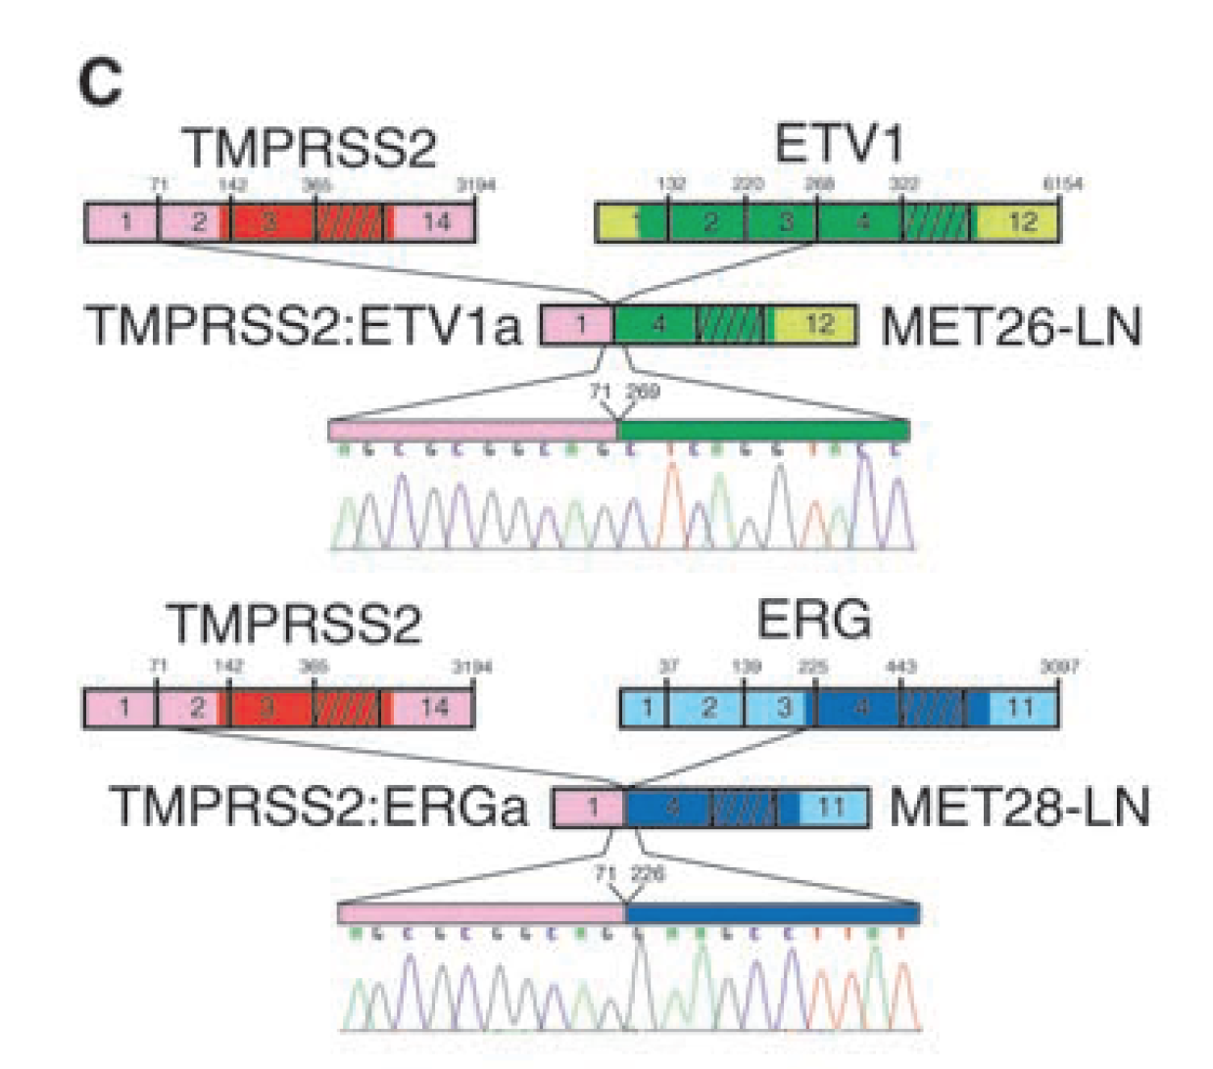
Classification of Gene Fusion Consequences
Deregulation of a proto-oncogene: Tx activation
(ex. 4) TMPRSS2-[ERG/ETV1] in Prostate Cancer
Serine protease
Upregulated in prostate
Tx factor
Fusion Transcript,
But no fusion protein
Tomlins, Science 2005
TMPRSS2 promoter drives over-expression of ETS-family Tx Factors
Notes:
Androgen response element of TMPRSS2
The ETS proteins regulate many target genes that modulate biological processes like cell growth, angiogenesis, migration, proliferation and differentiation.
Doesn’t involve coding region of TMPRSS2… mainly links up the TMPRSS2 promoter to drive expression of the Tx factor.

Slide 12
Classification of Gene Fusion Consequences
Deregulation of proto-oncogene: Tx activation
(ex. 5) IGH-MYC fusion in Burkitt’s Lymphoma
MYC
Tx factor
IGH
Immumnoglobulin heavy chain
IGH-MYC
Mitelman, 2007
MYC now constitutively driven by IGH promoter
awm
Notes:
* Class of gene function tied to function partner
* Transcription of some important genes must be tightly regulated
De-regulation of these genes by somatic genomic rearrangements induces cancer
Myc: transcription factor, cell cycle progression, apoptosis and cellular transformation, particularly in B-cells
Gene expression driven by immunoglobulin gene enhancers
Immunoglobulins recognize foreign antigens and initiate immune responses such as phagocytosis and the complement system. Each immunoglobulin molecule consists of two identical heavy chains and two identical light chains. This region represents the germline organization of the heavy chain locus. The locus includes V (variable), D (diversity), J (joining), and C (constant) segments. During B cell development, a recombination event at the DNA level joins a single D segment with a J segment; this partially rearranged D-J gene is then joined to a V segment. The rearranged V-D-J is then transcribed with the IGHM constant region; this transcript encodes a mu heavy chain. Later in development B cells generate V-D-J-Cmu-Cdelta pre-messenger RNA, which is alternatively spliced to encode either a mu or a delta heavy chain. Mature B cells in the lymph nodes undergo switch recombination, so that the V-D-J gene is brought in proximity to one of the IGHG, IGHA, or IGHE genes and each cell expresses either the gamma, alpha, or epsilon heavy chain. Recombination of many different V segments with several J segments provides a wide range of antigen recognition. Additional diversity is attained by junctional diversity, resulting from the random additional of nucleotides by terminal deoxynucleotidyltransferase, and by somatic hypermutation, which occurs during B cell maturation in the spleen and lymph nodes. Due to polymorphism, the numbers of functional V, J, and D genes differ among individuals and some V, D, J, and C segments may be pseudogenes. [provided by RefSeq, Oct 2013]
This gene is a proto-oncogene and encodes a nuclear phosphoprotein that plays a role in cell cycle progression, apoptosis and cellular transformation. The encoded protein forms a heterodimer with the related transcription factor MAX. This complex binds to the E box DNA consensus sequence and regulates the transcription of specific target genes. Amplification of this gene is frequently observed in numerous human cancers. Translocations involving this gene are associated with Burkitt lymphoma and multiple myeloma in human patients. There is evidence to show that translation initiates both from an upstream, in-frame non-AUG (CUG) and a downstream AUG start site, resulting in the production of two isoforms with distinct N-termini. [provided by RefSeq, Aug 2017]

Slide 13
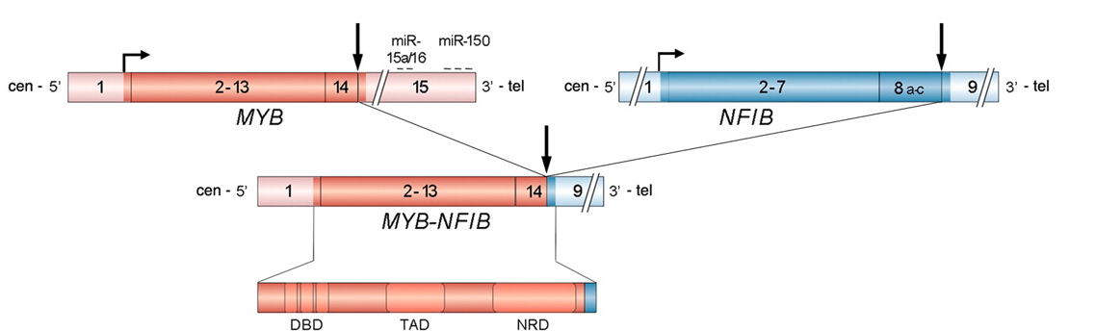
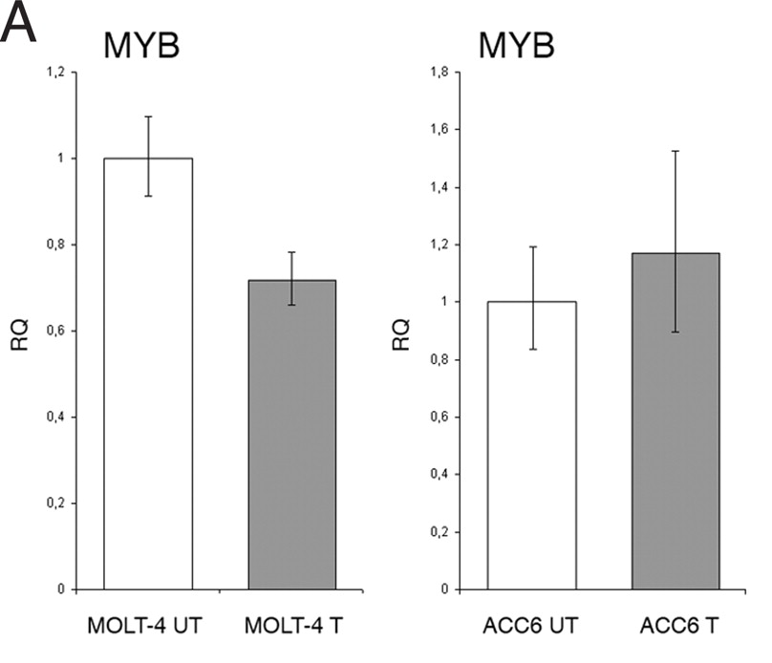
Classification of Gene Fusion Consequences
Deregulation of proto-oncogene: block Tx downregulation
Alternate forms of deregulation: microRNA binding
(ex. 6) MYB-NFIB in adenoid cystic carcinomas
MYB
Tx factor
NFIB
Tx factor
Transfect w/ miR oligos
MYB responds, Fusion doesn’t
Fusion removes miRNA-regulation of MYB
MYB Amplification
Fusion
Persson, 2009
awm
Notes:
Deletion of 3’ utr of MYB that contains microRNA binding sites for normal downregulation of expression.
Myb: transcription factor involved in Haematopoiesis
Transfection with additional miRNA affects amplification case but not fusion case
MicroRNA inhibits translation, promotes degradation
We suggest that deletion of these target sites
may disrupt repression of MYB leading to overexpression of MYBNFIB
transcripts and protein and to activation of critical MYB targets,
including genes associated with apoptosis, cell cycle control, cell
growth/angiogenesis, and cell adhesion.
ACC=adenoid cystic carcinomas
RQ=relative quantification from qrtpcr
UT = untransfected
T=transfected
Myb: This gene encodes a protein with three HTH DNA-binding domains that functions as a transcription regulator. This protein plays an essential role in the regulation of hematopoiesis. This gene may be aberrantly expressed or rearranged or undergo translocation in leukemias and lymphomas, and is considered to be an oncogene. Alternative splicing results in multiple transcript variants. [provided by RefSeq, Jan 2016]

Slide 14
Classification of Gene Fusion Consequences
Disrupt tumor suppressor gene
(ex. 7) LACTB2-NCOA2 Fusion in Colorectal Cancer
Enforced expression of NCOA2 reduces cell proliferation.
LACTB2 endonuclease
NCOA2 Tx Coactivator
Yu, 2015
Fusion disrupts NCOA2, reducing its expression and tumor suppression
awm
Notes:
Right: enforced expression of wild-type NCOA2 strongly inhibited the proliferation
LACTB2: Endoribonuclease; cleaves preferentially 3 to purine-pyrimidine dinucleotide motifs in single-stranded RNA. The cleavage product contains a free 3 -OH group. Has no activity with double-stranded RNA or DNA. Required for normal mitochondrial function and cell viability.
NCOA2: The protein encoded by this gene functions as a transcriptional coactivator for nuclear hormone receptors, including steroid, thyroid, retinoid, and vitamin D receptors. The encoded protein acts as an intermediary factor for the ligand-dependent activity of these nuclear receptors, which regulate their target genes upon binding of cognate response elements. This gene has been found to be involved in translocations that result in fusions with other genes in various cancers, including the lysine acetyltransferase 6A (KAT6A) gene in acute myeloid leukemia, the ETS variant 6 (ETV6) gene in acute lymphoblastic leukemia, and the hes related family bHLH transcription factor with YRPW motif 1 (HEY1) gene in mesenchymal chondrosarcoma. Alternative splicing results in multiple transcript variants. [provided by RefSeq, Mar 2016]

Slide 15
Classification of Gene Fusion Consequences
Multiple mechanisms are possible
(ex. 8) MYB-QKI rearrangements in angiocentric glioma
MYB Tx factor
QKI RNA processing
Functional Fusion Protein
Bandopadhayay, 2016
awm
Notes:
Three mechanisms:
MYB activation by truncation
Enhancer translocation driving aberrant MYB-QKI expression
Hemizygous loss of the tumor suppressor QKI
MYB: Transcriptional activator; DNA-binding protein that specifically recognize the sequence 5-YAAC[GT]G-3. Plays an important role in the control of proliferation and differentiation of hematopoietic progenitor cells.
QKI: The protein encoded by this gene is an RNA-binding protein that regulates pre-mRNA splicing, export of mRNAs from the nucleus, protein translation, and mRNA stability
Figure 8 MYB-QKI rearrangement contributes to oncogenesis through at least three mechanisms. The MYB-QKI rearrangement disrupts both MYB and QKI, resulting in hemizygous deletion of the 3′ ?portion of MYB and the 5′ ?portion of QKI. (1) This results in proximal translocation of H3K27ac-bound enhancers in the 3′ ?region of QKI to the MYB promoter, resulting in MYB promoter activation. (2) The MYB-QKI fusion protein that is expressed is oncogenic, functions as a transcription factor and exhibits the ability to bind to and activate the MYB promoter, resulting in an autoregulatory feedback loop. (3) Hemizygous loss of QKI results in suppression of the expression of QKI, which functions as a tumor-suppressor gene.

Slide 16
Classification of Gene Fusion Consequences
Multiple mechanisms are possible
(ex. 8) MYB-QKI rearrangements in angiocentric glioma
MYB Tx factor
QKI RNA processing
Functional Fusion Protein
Bandopadhayay, 2016
awm
Notes:
Three mechanisms:
MYB activation by truncation
Enhancer translocation driving aberrant MYB-QKI expression
Hemizygous loss of the tumor suppressor QKI
MYB: Transcriptional activator; DNA-binding protein that specifically recognize the sequence 5-YAAC[GT]G-3. Plays an important role in the control of proliferation and differentiation of hematopoietic progenitor cells.
QKI: The protein encoded by this gene is an RNA-binding protein that regulates pre-mRNA splicing, export of mRNAs from the nucleus, protein translation, and mRNA stability
Figure 8 MYB-QKI rearrangement contributes to oncogenesis through at least three mechanisms. The MYB-QKI rearrangement disrupts both MYB and QKI, resulting in hemizygous deletion of the 3′ ?portion of MYB and the 5′ ?portion of QKI. (1) This results in proximal translocation of H3K27ac-bound enhancers in the 3′ ?region of QKI to the MYB promoter, resulting in MYB promoter activation. (2) The MYB-QKI fusion protein that is expressed is oncogenic, functions as a transcription factor and exhibits the ability to bind to and activate the MYB promoter, resulting in an autoregulatory feedback loop. (3) Hemizygous loss of QKI results in suppression of the expression of QKI, which functions as a tumor-suppressor gene.

Slide 17
Classification of Gene Fusion Consequences
Multiple mechanisms are possible
(ex. 8) MYB-QKI rearrangements in angiocentric glioma
MYB Tx factor
QKI RNA processing
Functional Fusion Protein
Bandopadhayay, 2016
awm
Notes:
Three mechanisms:
MYB activation by truncation
Enhancer translocation driving aberrant MYB-QKI expression
Hemizygous loss of the tumor suppressor QKI
MYB: Transcriptional activator; DNA-binding protein that specifically recognize the sequence 5-YAAC[GT]G-3. Plays an important role in the control of proliferation and differentiation of hematopoietic progenitor cells.
QKI: The protein encoded by this gene is an RNA-binding protein that regulates pre-mRNA splicing, export of mRNAs from the nucleus, protein translation, and mRNA stability
Figure 8 MYB-QKI rearrangement contributes to oncogenesis through at least three mechanisms. The MYB-QKI rearrangement disrupts both MYB and QKI, resulting in hemizygous deletion of the 3′ ?portion of MYB and the 5′ ?portion of QKI. (1) This results in proximal translocation of H3K27ac-bound enhancers in the 3′ ?region of QKI to the MYB promoter, resulting in MYB promoter activation. (2) The MYB-QKI fusion protein that is expressed is oncogenic, functions as a transcription factor and exhibits the ability to bind to and activate the MYB promoter, resulting in an autoregulatory feedback loop. (3) Hemizygous loss of QKI results in suppression of the expression of QKI, which functions as a tumor-suppressor gene.

Slide 18

Mechanisms for Fusion to Drive Cancer
Activating cellular proliferation via:
Protein: cell signaling cascades (eg. kinases)
RNA:
transcriptional activation (eg. Tx factors)
Post-transcriptional deregulation
(eg. removing regulatory motifs)
DNA: chromatin remodeling
(eg. Repositioning enhancers,
altering epigenetic marks)
TMTOWTDI !

Slide 19
Genomic Effects of Gene Fusions (signatures allowing detection)
Chimeric DNA sequence
Chimeric mRNA sequence
Expression changes
awm
Notes:
* Each effect provides a specific genomic signature allowing detection

Slide 20
Discovery Platforms
Cytogenetics - Karyotyping
Labour intensive
Low throughput
Chromosome Banding Analysis
Spectral Karyotyping
Jarosová, 2000
Markovic, 2000
awm
Notes:
Banding: metaphase chromosome stained with trypsin, AT regions stain more darkly

Slide 21
Discovery Platforms
Cytogenetics – Fluorescence In-Situ Hybridization (FISH)
Targeted
Low throughput
FISH Probes (Come Together Assay)
FISH Image
courtesy cytotest.com
Vaniawala, 2015
awm

Slide 22
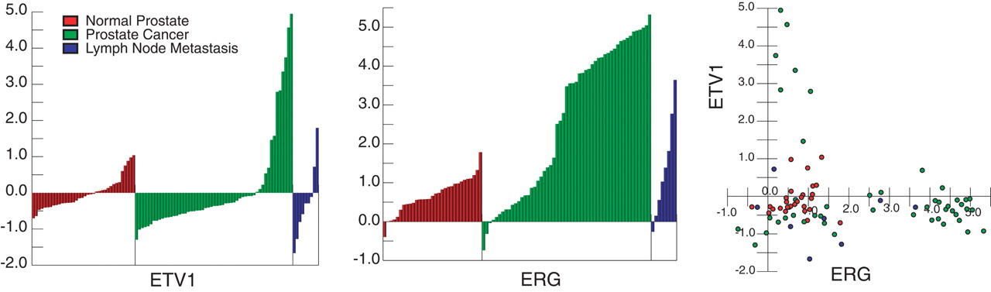
Discovery Platforms
Expression Arrays
COPA: Cancer Outlier Profile Analysis
Inexpensive
No sequence information
Use RACE (rapid amplification of cDNA ends) to find potential fusion partner.
Discovery of ETS-family Tx factor fusions in Prostate Cancer
Median average expr difference
Patient sample
Tomlins et al., 2005
awm
Notes:
* Discovery of ETS fusions in prostate cancer
“COPA” method
* No longer used since the discovery of RNA-Seq
* Androgen regulated TMPRSS2

Slide 23
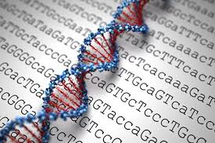
Discovery Platforms
Genome Sequencing
Comprehensive
Expensive
No expression information
Discovery of VTI1A-TCF7L2 fusion in
colorectal adenocarcinomas
Bass et al., 2011
awm
Notes:
* Detect rearrangement breakpoints
* Infer fusion based on location of breakpoints connecting distinct genes
* Complicated by complex rearrangements / insertions
Here we report whole-genome sequencing from nine individuals with colorectal cancer, including primary colorectal tumors and matched adjacent non-tumor tissues, at an average of 30.7. and 31.9. coverage, respectively. We identify an average of 75 somatic rearrangements per tumor, including complex networks of translocations between pairs of chromosomes. Eleven rearrangements encode predicted in-frame fusion proteins, including a fusion of VTI1A and TCF7L2 found in 3 out of 97 colorectal cancers. Although TCF7L2 encodes TCF4, which cooperates with b-catenin4 in colorectal carcinogenesis5,6, the fusion lacks the TCF4 b-catenin–binding domain. We found a colorectal carcinoma cell line harboring the fusion gene to be dependent on VTI1A-TCF7L2 for anchorage-independent growth using RNA interference-mediated knockdown.

Slide 24
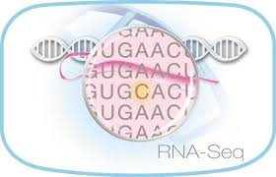
Discovery Platforms
mRNA Sequencing (RNA-Seq)
Inexpensive
Expression information
Exact fusion transcript identified
Not as comprehensive as genome sequencing
Discovery of MAST and Notch
fusions in breast cancer
Robinson et al., 2011
awm
Notes:
* Exons of both genes must be expressed in a fusion transcript
* Juxstaposition to promotor/enhancer elements of another gene may not be detectable

Slide 25
Massive increase in fusion discovery driven by sequencing
21k
Majority of fusions were more recently discovered by RNA-Seq
2018
awm
Mertens, 2015
Notes:
The number of new gene fusions reported each year from 1982 to 2014 (REF. 5) is shown. Unbiased gene fusions are those detected by deep sequencing, whereas guided gene fusions represent those identified as the result of molecular analyses directed by prior (cyto)genetic information.

Slide 26
How RNA-seq data is generated
Total RNA
polyA-capture
Enzymatic or mechanical fragmentation
awm
Notes:
* Focusing on illumina sequencing since it is the most common, and arguably
the current defacto standard
* Important: size selection results in a specific length distribution for fragments,
and this length distribution will be important during fusion prediction

Slide 27
Chimeric Fusion Genes Produce Chimeric RNA-Seq Reads
Fusion Gene
Fusion Transcript
awm
Notes:
* Spanning reads also called:
- Bridging reads
* Split reads also called:
- Spanning reads

Slide 28
Chimeric Fusion Genes Produce Chimeric RNA-Seq Reads
Fusion Gene
Infer fusion gene
Fusion Transcript
Infer fusion transcript
Notes:
* Spanning reads also called:
- Bridging reads
* Split reads also called:
- Spanning reads

Slide 29
Detecting Fusion Transcripts from Paired-end RNA-Seq Reads
(Discordant Spanning reads and Fusion Junction Reads)
Align reads to the genome,
Identify discordant pairs and junction reads.
/1
Junction read
/1
Chr-A
Spanning frag
/2
/2
Chr-B

Slide 30
Detecting Fusion Transcripts Using De novo Transcript Assemblies
De novo assembly
Align transcripts
to genome
Chr-A
Chr-B

Slide 31
RNA-Seq and the Alignment Problem
Problem: assign observed reads to genomic loci
Alternatively: assign to genes
Chimeric RNA-Seq fragment
awm
Notes:
### Mapping and alignment problems
Alignment problem: find a matching between read nucleotides and
reference nucleotides to minimize a score penalizing matches /
mismatches / indels.
Mapping problem: find the genomic loci that minimizes the alignment
score.
It is assumed that for a reasonable penalty on indels, an alignment
of a read will be restricted to one or possibly a handful of genomic
loci. This fact is leveraged during mapping and alignment. The
mapping locations are found using hash based lookups, and alignments
are extended.

Slide 32
Paired End Read Alignments Inform Fusion Discovery
Paired end read alignments can provide approximate breakpoint information
Split-reads are required for precise junction identification.
Chimeric RNA-Seq fragment
awm
Notes:
* Most common analysis
* Map each end independently, for ends mapping to distinct genes try
to identify reads split by the fusion boundary.
* For early methods, use all pairs of exons
* Newer methods use dynamic programming and can find novel junctions
not at exon boundaries

Slide 33
Choice of Reference affects Mapping Rates
awm
Zhao and Zhang, 2016
http://dx.doi.org/10.5772/61197
Notes:
Choice of reference important, genome + transcriptome results in more mapped reads and less multi mapped reads
### Choice of reference
The choice of reference sequences for alignment is important.
Mapping to the genome is complicated by _spliced_ reads crossing
introns. Spliced reads are more difficult to align since multiple
non-contiguous mapping locations must be identified for each read.
Mapping to transcripts will miss spliced reads from novel introns.
Currently, a hybrid approach is usually taken, mapping to transcript
sequences, and also to the genome for novel introns. Often mappings
to transcripts are prioritized, and only the remaining reads that
cannot be mapped are then mapped to the genome for novel intron
discovery (eg TopHat2.)

Slide 34
Choice of Target Influences Read Mappings and Fusion Predictions
Complexity of mapping reads
Genome only
Vs.
Mis-mapped reads (belong elsewhere in the genome)
Transcriptome only
Restricted to reference transcripts (no novel exons allowed)
Vs.
+
Genome & Transcriptome
(most rigorous)
awm
Notes:
Choice of reference important, genome + transcriptome results in more mapped reads and less multi mapped reads
### Choice of reference
The choice of reference sequences for alignment is important.
Mapping to the genome is complicated by _spliced_ reads crossing
introns. Spliced reads are more difficult to align since multiple
non-contiguous mapping locations must be identified for each read.
Mapping to transcripts will miss spliced reads from novel introns.
Currently, a hybrid approach is usually taken, mapping to transcript
sequences, and also to the genome for novel introns. Often mappings
to transcripts are prioritized, and only the remaining reads that
cannot be mapped are then mapped to the genome for novel intron
discovery (eg TopHat2.)

Slide 35
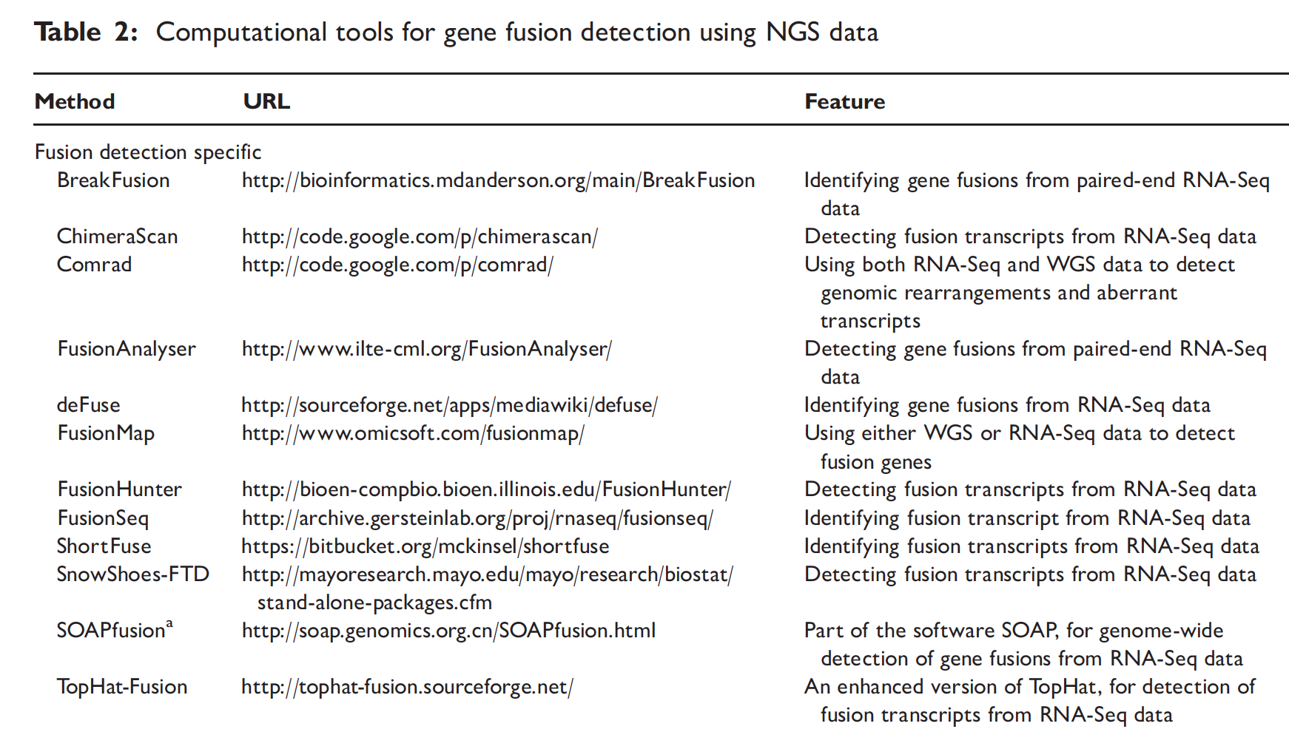
* Table from Wang et al. Briefings in Bioinformatics. 2012
And many more since 2012, including:
BARNACLE (2013)
PRADA (2014)
FusionCatcher (2014)
TRUP (2015)
JAFFA (2015)
NCLscan (2015)
IDP-fusion (2015)
INTEGRATE (2016)
InFusion (2016)
ChimeRScope (2017)
ChimPipe (2017)
STAR-Fusion (2017)
Pizzly (2017)

Slide 36
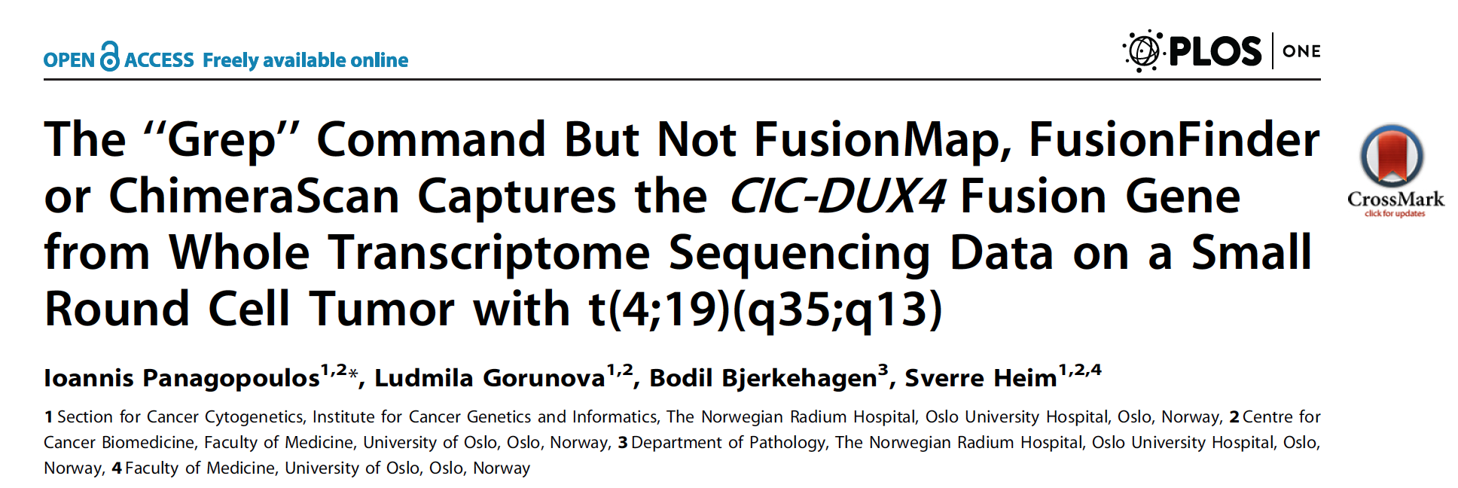

When all else fails…
“In conclusion, FusionMap, FusionFinder, and ChimeraScan generated a plethora of fusion
transcripts but did not detect the biologically important CIC-DUX4 chimeric transcript. … The ‘‘grep’’ command is an excellent tool to capture chimeric
transcripts from RNA sequencing data”
Notes:
Abstract
Whole transcriptome sequencing was used to study a small round cell tumor in which a t(4;19)(q35;q13) was part of the
complex karyotype but where the initial reverse transcriptase PCR (RT-PCR) examination did not detect a CIC-DUX4 fusion
transcript previously described as the crucial gene-level outcome of this specific translocation. The RNA sequencing data
were analysed using the FusionMap, FusionFinder, and ChimeraScan programs which are specifically designed to identify
fusion genes. FusionMap, FusionFinder, and ChimeraScan identified 1017, 102, and 101 fusion transcripts, respectively, but
CIC-DUX4 was not among them. Since the RNA sequencing data are in the fastq text-based format, we searched the files
using the ‘‘grep’’ command-line utility. The ‘‘grep’’ command searches the text for specific expressions and displays, by
default, the lines where matches occur. The ‘‘specific expression’’ was a sequence of 20 nucleotides from the coding part of
the last exon 20 of CIC (Reference Sequence: NM_015125.3) chosen since all the so far reported CIC breakpoints have
occurred here. Fifteen chimeric CIC-DUX4 cDNA sequences were captured and the fusion between the CIC and DUX4 genes
was mapped precisely. New primer combinations were constructed based on these findings and were used together with a
polymerase suitable for amplification of GC-rich DNA templates to amplify CIC-DUX4 cDNA fragments which had the same
fusion point found with ‘‘grep’’. In conclusion, FusionMap, FusionFinder, and ChimeraScan generated a plethora of fusion
transcripts but did not detect the biologically important CIC-DUX4 chimeric transcript; they are generally useful but
evidently suffer from imperfect both sensitivity and specificity. The ‘‘grep’’ command is an excellent tool to capture chimeric
transcripts from RNA sequencing data

Slide 37
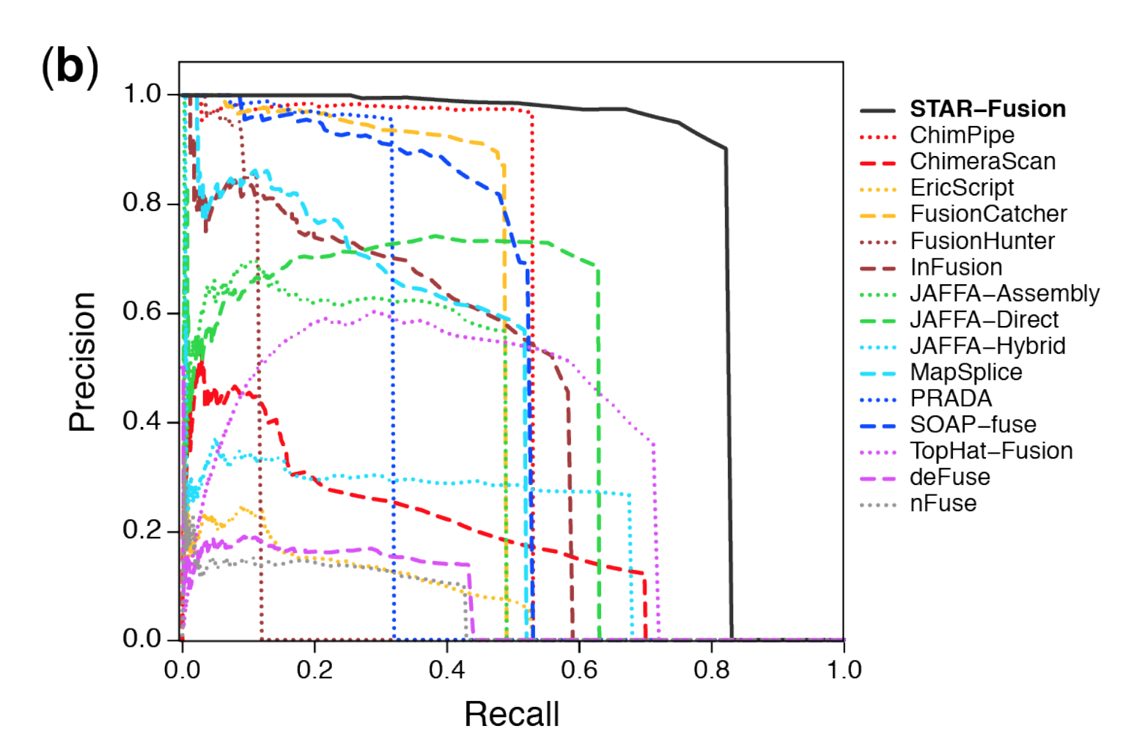
Benchmarking Fusion-finding Tools
Precision – Recall Curves
Simulated data
5 replicates
2500 Simulated fusions
30M PE sim RNA-Seq data
Genuine data
65 Cancer Cell Lines
Precision = TP / (TP + FP)
Recall = TP / (TP + FN)
Accuracy = area under the curve (AUC)
Haas & Dobin et al, bioRxiv, 2017
Notes:
In this paper, we benchmark STAR-Fusion and compare it to a dozen other fusion-finding tools, leveraging simulated fusions with simulated RNA-Seq data as well as genuine rna-seq data from cancer cell lines.
Our accuracy assessment methods were rigorous and relied on using Precision-Recall curves, where we plot precision and recall for predictions as a function of the minimum number of RNA-Seq reads supporting the fusion predictions.
We computed area under the curve (AUC) as the accuracy measurement.

Slide 38
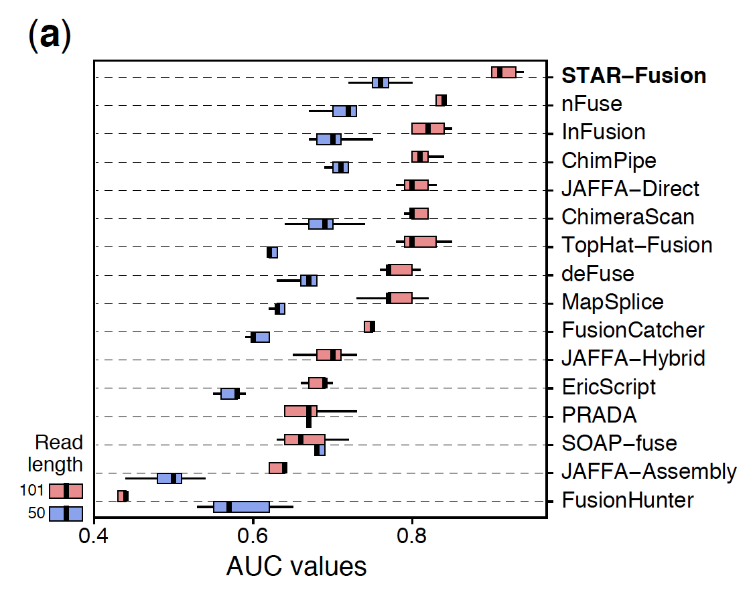
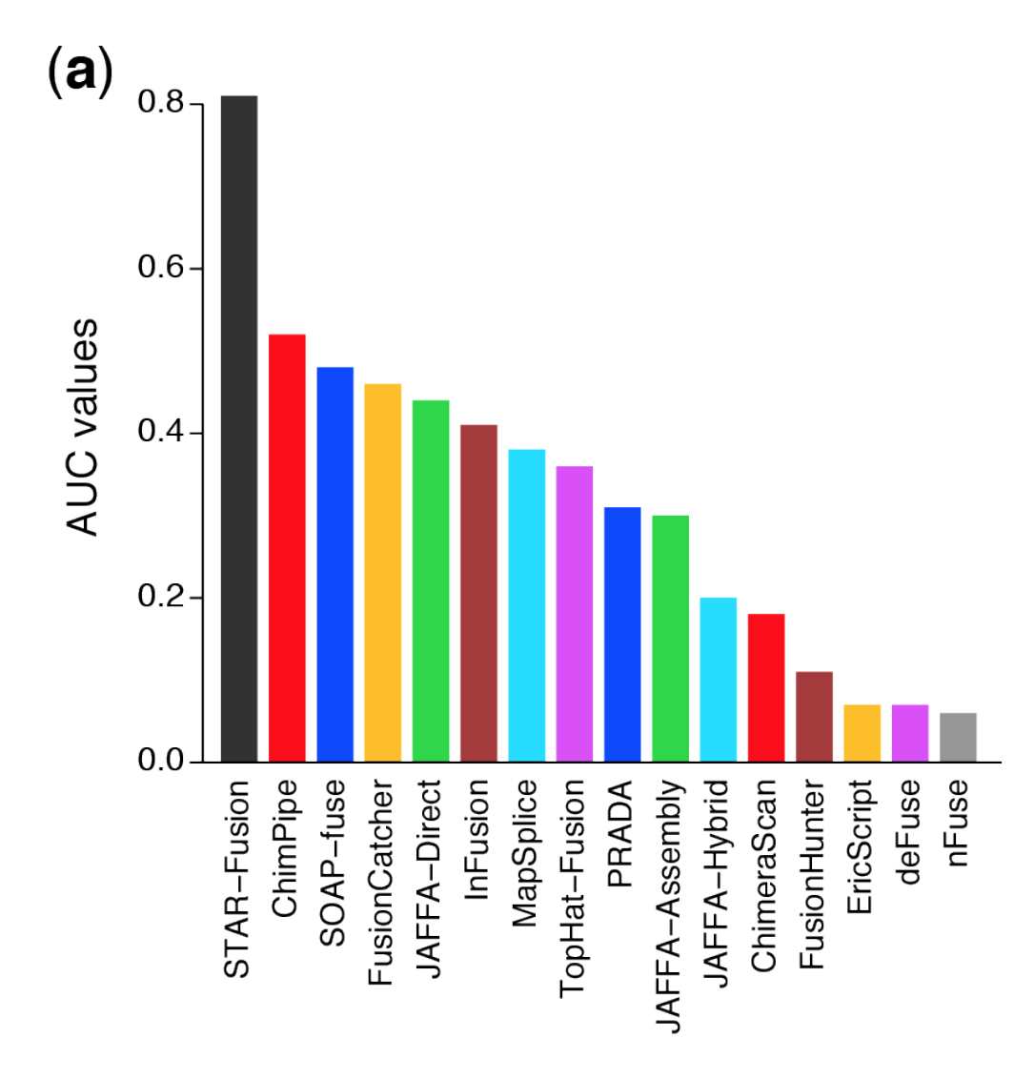
Benchmarking Fusion-finding Tools
Fusion prediction accuracy on simulated rna-seq data
Fusion prediction accuracy on 65 cancer cell lines
Haas & Dobin et al, bioRxiv, 2017

Slide 39
Sources of False Positives
Technical artifacts
Alignment artifacts
Homologous genes
High expression (ribosomal RNA) + read errors
Chimeric read artifacts
Reverse transcriptase template switching
Ligation artifacts
Biological artifacts
Natural sources of rearrangement
Germline variants, transposons, NUMT
Transcription Induced Chimeras (Read-throughs)
Trans-splicing
awm
Notes:
NUMT, pronounced "new might,” is an acronym for “nuclear mitochondrial DNA segment” coined by evolutionary geneticist, Jose V. Lopez, which describes a transposition of any type of cytoplasmic mitochondrial DNA into the nuclear genome of the eukaryotic organisms.

Slide 40
Mitigating Fusion Artifacts
Apply Bioinformatic Filters
Screen results against existing databases
RepeatMasker, NUMT
Gene lists – ‘red herrings’ (more later…)
Remove events involving ribosomal RNA, HLA
Transcription Induced Chimeras (Read-throughs)
Easily identified as fusions between adjacent genes
Consider a minimum distance threshold.
Consider the strength of the evidence
Require minimal number of supporting reads / total reads
Examine the transcript breakpoint
Canonical splicing? If not…. greater chance of it being an RT or ligation artifact.
Notes:
* Abberant open chromatin results in skipped transcription stop sites and
results in co-transcription of adjacent genes

Slide 41
Supervised Fusion Analysis
Given a panel of fusions of interest:
Capture any evidence for specific fusions
Characterize the evidence:
Scoring the fusion
Expression of fusion vs. non-fused alleles
Functional impact (frameshift vs. in-frame, etc.)
Facilitate visualization of the data

Slide 42


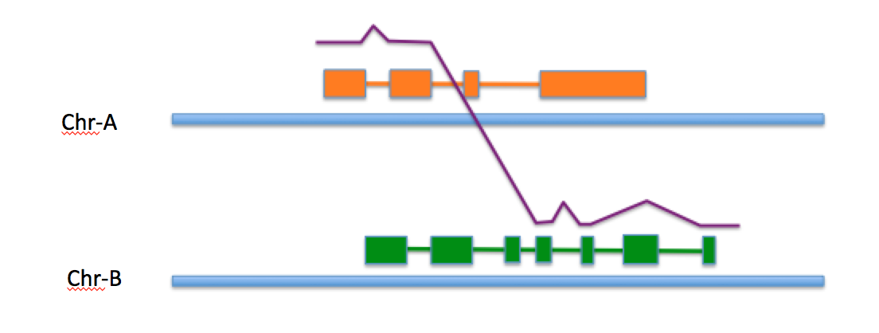
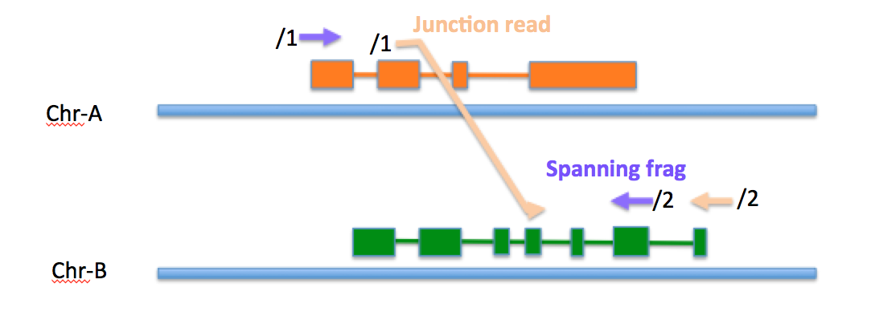
Bottom-up Fusion ‘In silico Validation’ Using FusionInspector
Add to whole genome. Align reads, score and assess.
/2
/1
/2
* STAR enhancements to support FusionInspector
Make mini-fusion contigs
STAR-Fusion
PRADA
SOAPfuse
FusionCatcher
…
TrinityFuse
OasesFuse
JAFFA
DISCASM
…
All fusion
predictions

Slide 43
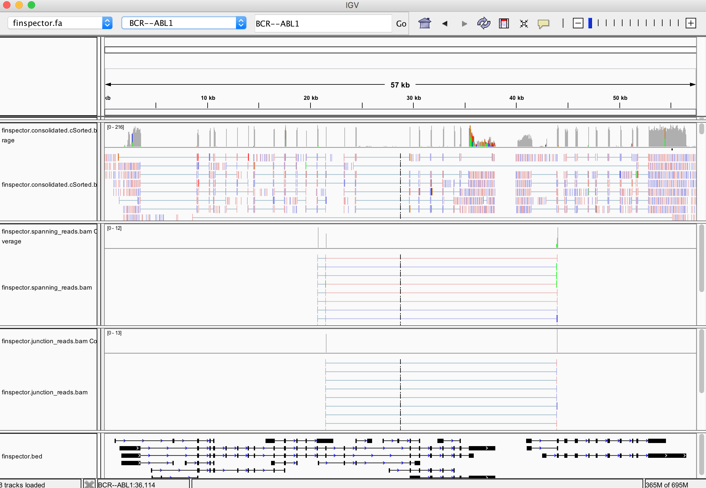
Using IGV for Visualization with FusionInspector
All aligned reads
Fusion spanning frags
Fusion split-reads
BCR
Condensed gene structures (shrunken introns)
ABL

Slide 44
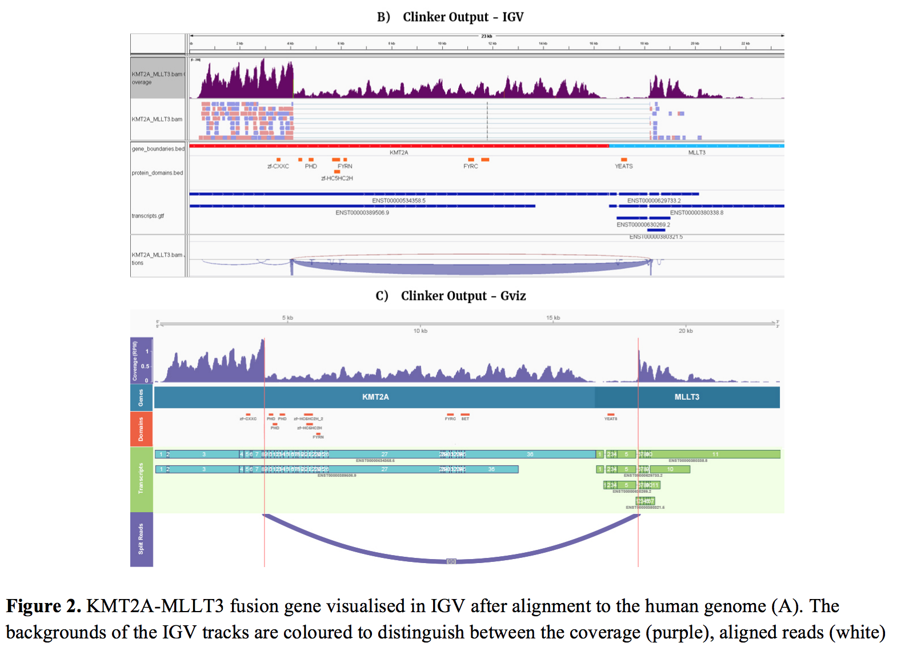
Supervised Fusion Study via Clinker
Schmidt et al., bioRxiv, 2017

Slide 45
Prioritizing Fusion Candidates (1)
Expression
Expression outlier
Wild type expression profile found truncated
Recurrence
Same fusion pair in other samples
One of the fused genes is fused in other samples
Corroborating rearrangement
Many balanced rearrangements are known initiators of tumorigenesis
A
B
A
D
awm
C
D
C
B

Slide 46
Prioritizing Fusion Candidates (2)
Gene function
Implicated in cancer
Involve a kinase in the 3’ position
Could serve as a drug target
Function preserved by fusion
Fusion preserves reading frame of both genes
Strength of evidence supporting the fusion call
Numbers of RNA-Seq fragments
Additional evidence from DNA? (WGS, CNV, etc…)
awm
Notes:
Cancer gene cencus

Slide 47
Gene Fusion Partners
Tyrosine kinases
Transfer a phosphate group from ATP to a protein
Transmit signals and regulate complex processes
Transcription factors
Binds to specific DNA sequences
Regulates transcription
Oncogenes
Regulate apoptosis
Promote proliferation
Genes:
ABL, PDGFRA, PDGFRB, FGFR1, SYK, RET, JAK2, ALK
Genes:
ETV1, ETV4, ETV5, ETV6, ERG, MYC
Genes:
BCL2, MYC, BRAF
awm
Notes:
### Tyrosine kinases:
Many of the tyrosine kinases regulate growth, differentiation, and cell division. The fusion gene co-opts these domains resulting in increased proliferation.
ABL
cytoplasmic and nuclear protein tyrosine kinase that has been implicated in processes of cell differentiation, cell division, cell adhesion, and stress response
PDGFRA, PDGFRB
cell surface tyrosine kinase receptor for members of the platelet-derived growth factor family. mitogens for cells of mesenchymal origin
FGFR1
extracellular portion of the protein interacts with fibroblast growth factors, setting in motion a cascade of downstream signals, ultimately influencing mitogenesis and differentiation
SYK
non-receptor type Tyr protein kinase, involved in coupling activated immunoreceptors to downstream signaling events that mediate diverse cellular responses, including proliferation, differentiation, and phagocytosis
RET
receptor tyrosine kinases, which are cell-surface molecules that transduce signals for cell growth and differentiation
JAK2
protein tyrosine kinase involved in a specific subset of cytokine receptor signaling pathways
ALK
receptor tyrosine kinase, which belongs to the insulin receptor superfamily
### Transcription factors
over-expressing a transcription factor results in increased expression in targeted genes, often
ETV1, ETV4, ETV5, ETV6, ERG
modulate biological processes like cell growth, angiogenesis, migration, proliferation and differentiation
MYC
multifunctional, nuclear phosphoprotein that plays a role in cell cycle
progression, apoptosis and cellular transformation. transcription factor that regulates
transcription of specific target genes
### Oncogenes
BCL2
encodes an integral outer mitochondrial membrane protein that blocks the apoptotic death of some cells
such as lymphocytes
BRAF
encodes a protein belonging to the raf/mil family of serine/threonine protein kinases. This protein plays a role in regulating the MAP kinase/ERKs signaling pathway, which affects cell division, differentiation, and secretion
Note: the oncogene / proto-oncogene examples are often also tyrosine kinases

Slide 48
Fusion Landscape
Fusions / Sample
Landscape studies of thousands of tumours
Yoshihara et al., 2015
Stransky et al., 2014 (kinases)
Genes fused across multiple cancers
Mechanisms of formation
copy number / genome instability
balanced?
Prevalence of fusions for each cancer type
(genome Instability)
w/ CNV
Fusions w/ or w/o CNV
w/o CNV
awm
Yoshihara, 2015
Notes:
Majority of fusions across cancer types created by unbalanced rearrangement
Majority result of genomic instability
Potentially druggable kinase fusions involving ALK, ROS, RET, NTRK and FGFR gene families were detected in:
bladder carcinoma (3.3%)
glioblastoma (4.4%)
head and neck cancer (1.0%)
low-grade glioma (1.5%), lung adenocarcinoma (1.6%)
lung squamous cell carcinoma (2.3%)
thyroid carcinoma (8.7%)
Bladder urothelial carcinoma 121 16
Breast cancer 1019 110
Glioblastoma multiforme 158 —
Head and neck squamous cell carcinoma 300 37
Clear cell renal cell carcinoma 474 71
Acute myeloid leukemia 171 —
Low-grade glioma 266 —
Lung adenocarcinoma 487 57
Lung squamous cell carcinoma 220 17
Ovarian serous cystadenocarcinoma 400 —
Prostate adenocarcinoma 178 —
Skin cutaneous melanoma 78 —
Thyroid carcinoma 494 56
Total 4366 364

Slide 49
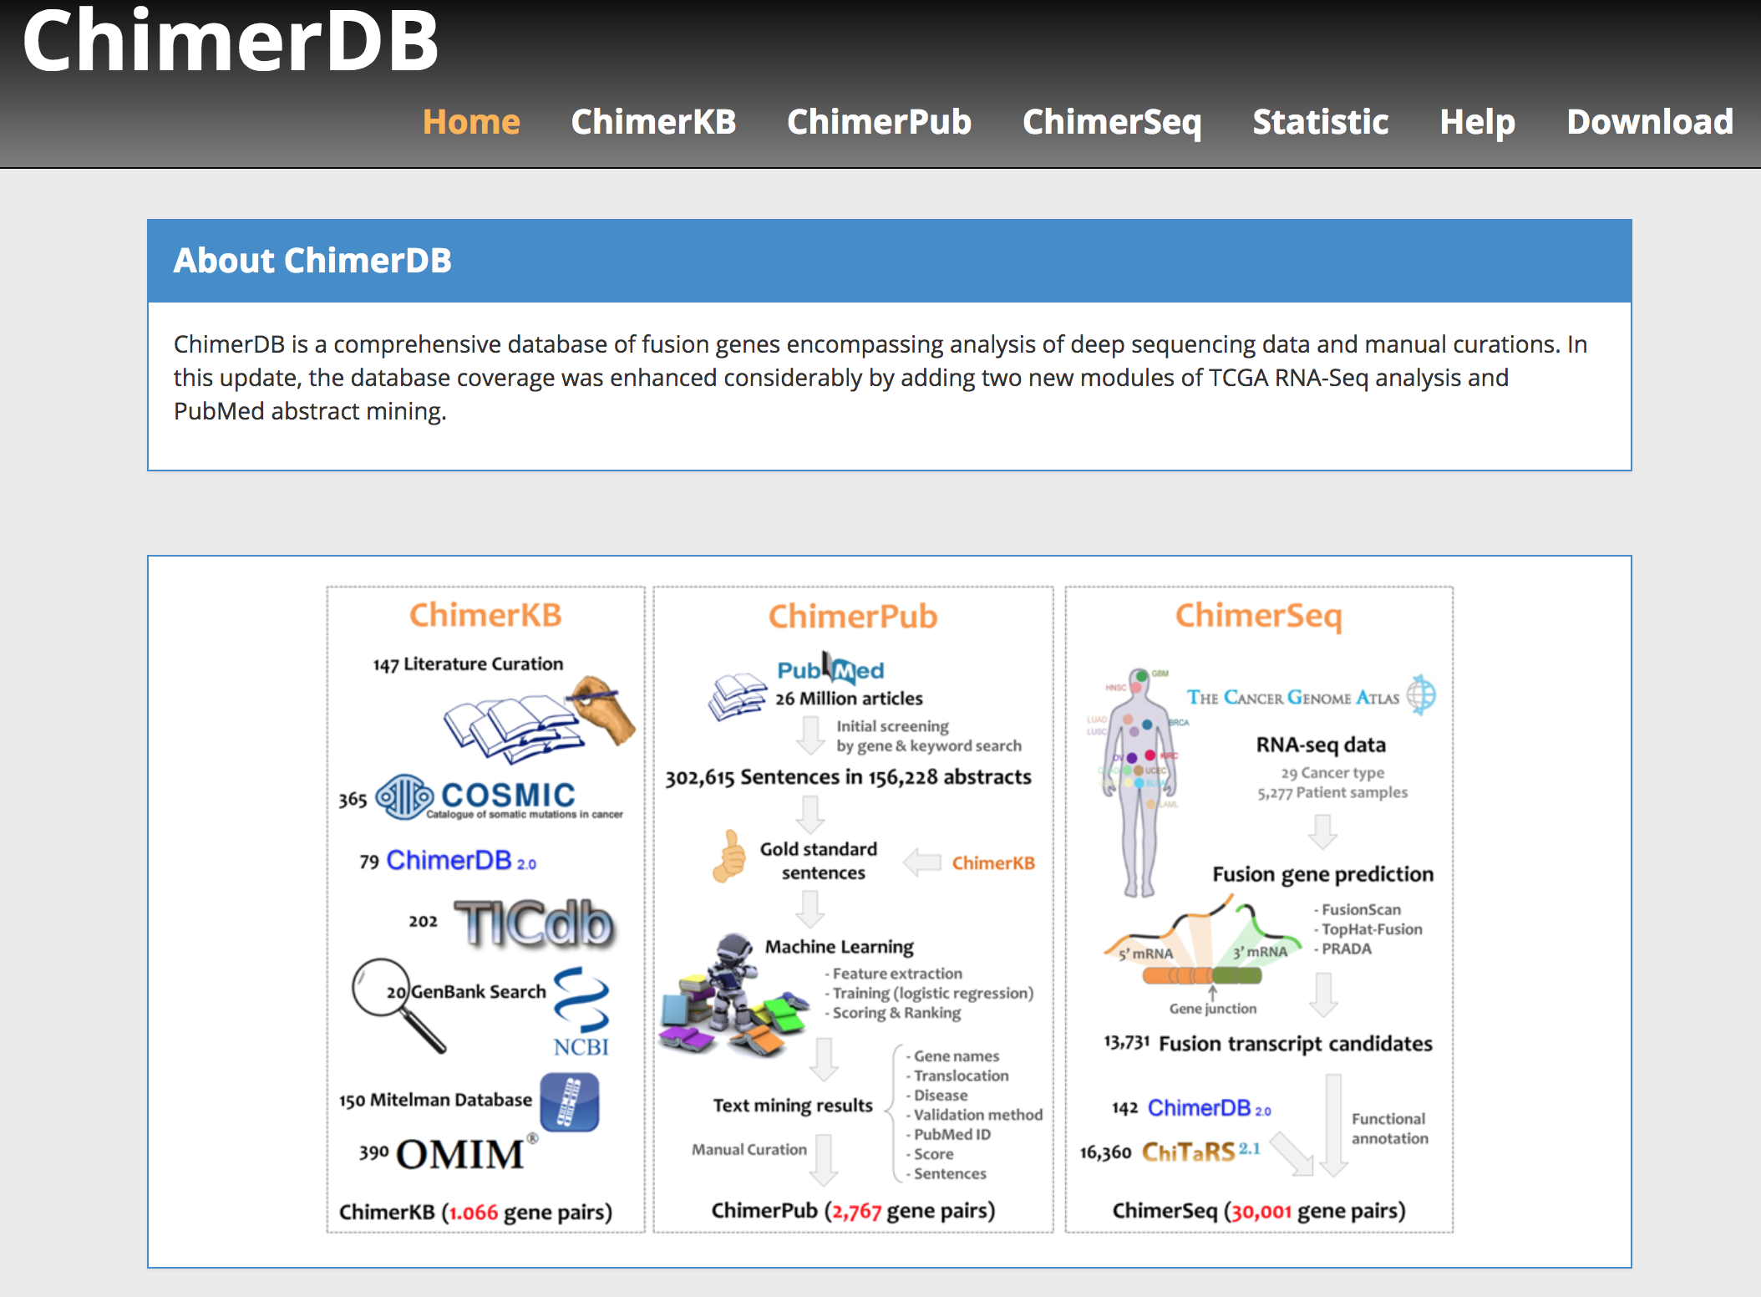
ChimerDB 3: ChimerKB, ChimerPub and ChimerSeq
http://ercsb.ewha.ac.kr/fusiongene

Slide 50
Some Genes are Promiscuous Fusion Partners
Gene fusions form a scale-free network
Connectivity follows a power-law
90% of fusion partners form 3 clusters
awm
Based on fusions identified pre-NGS era
Mitelman, 2007
Notes:
Scale Free Network:
* degree distribution follows a power law
* the fraction P(k) of nodes in the network having k connections to other nodes goes for large values of k as P(k) ~ k^{-\gamma}
* A handful of genes are highly promiscuous, but most are connected to only a few other genes
Three clusters:
1. haematological ETV6, IGH and NUP98 fusions, the predominantly lymphoma-associated BCL6 fusions as well as epithelial RET fusions
2. predominantly haematological MLL fusions connected to the HMGA2 fusions typically found in soft tissue tumours
3. lymphoma-associated ALK fusions, the carcinoma-associated transcription factor for IGHM enhancer 3 (TFE3) fusions, and the sarcoma-associated EWSR1 fusions.
Targeted / guided approaches overestimate connectivity
FISH probes
RACE assays

Slide 51
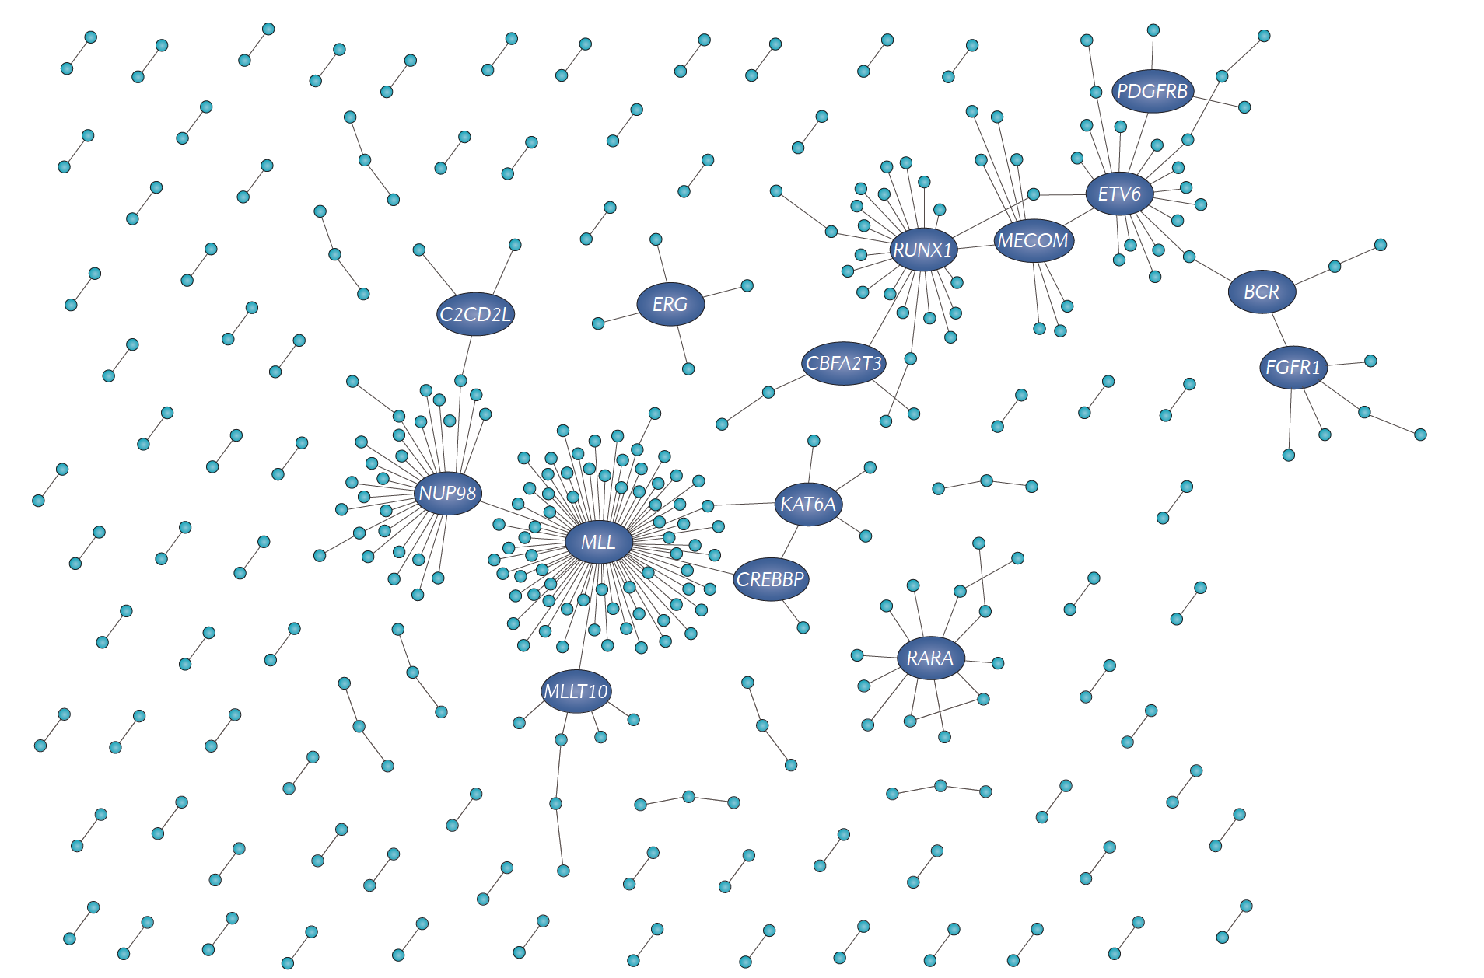
Cancer-Specific Fusion Networks
acute myeloid leukaemia (AML)
Ovarian Cancer
Un-clustered fusions are heavily enriched
for those identified via NGS methods
Passengers vs. Drivers? Artifacts?
Mertens, NRC 2015

Slide 52
Gene Fusion Databases
TCGA Gene Fusion portal
Predictions from Yoshihara et al., 2015
Expression and gene structure
COSMIC gene fusions
Curated from publications
Fusion info, tissue, and publications
(Licensing required to access full DB)
http://www.tumorfusions.org
http://cancer.sanger.ac.uk/cosmic/fusion
awm

Slide 53
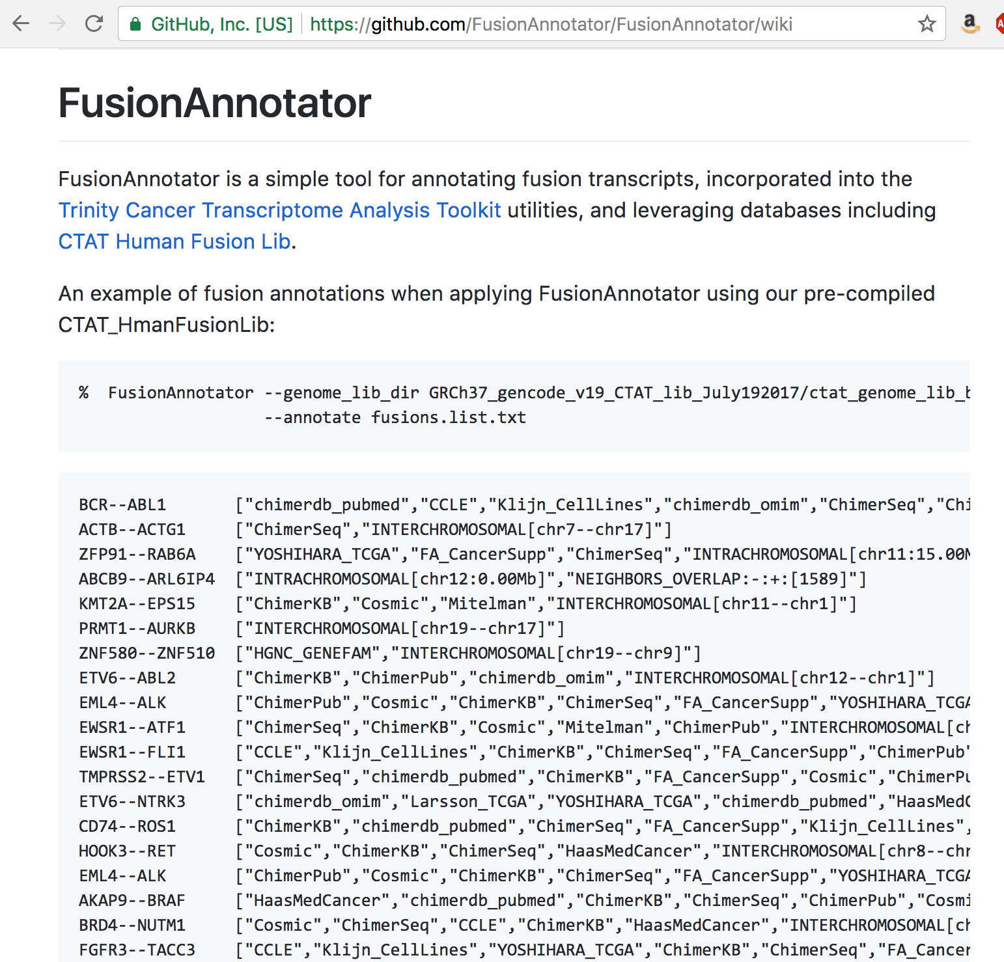

Slide 54
Localized expression imbalances result from gene fusions
True gene fusions often associated with truncated expression in fused genes
Expression analysis of fusion transcripts can identify true positives
Caveat: balanced rearrangements
ERBB3-CRADD
CMKLR1-HNF1A
awm
McPherson et al., 2010

Slide 55
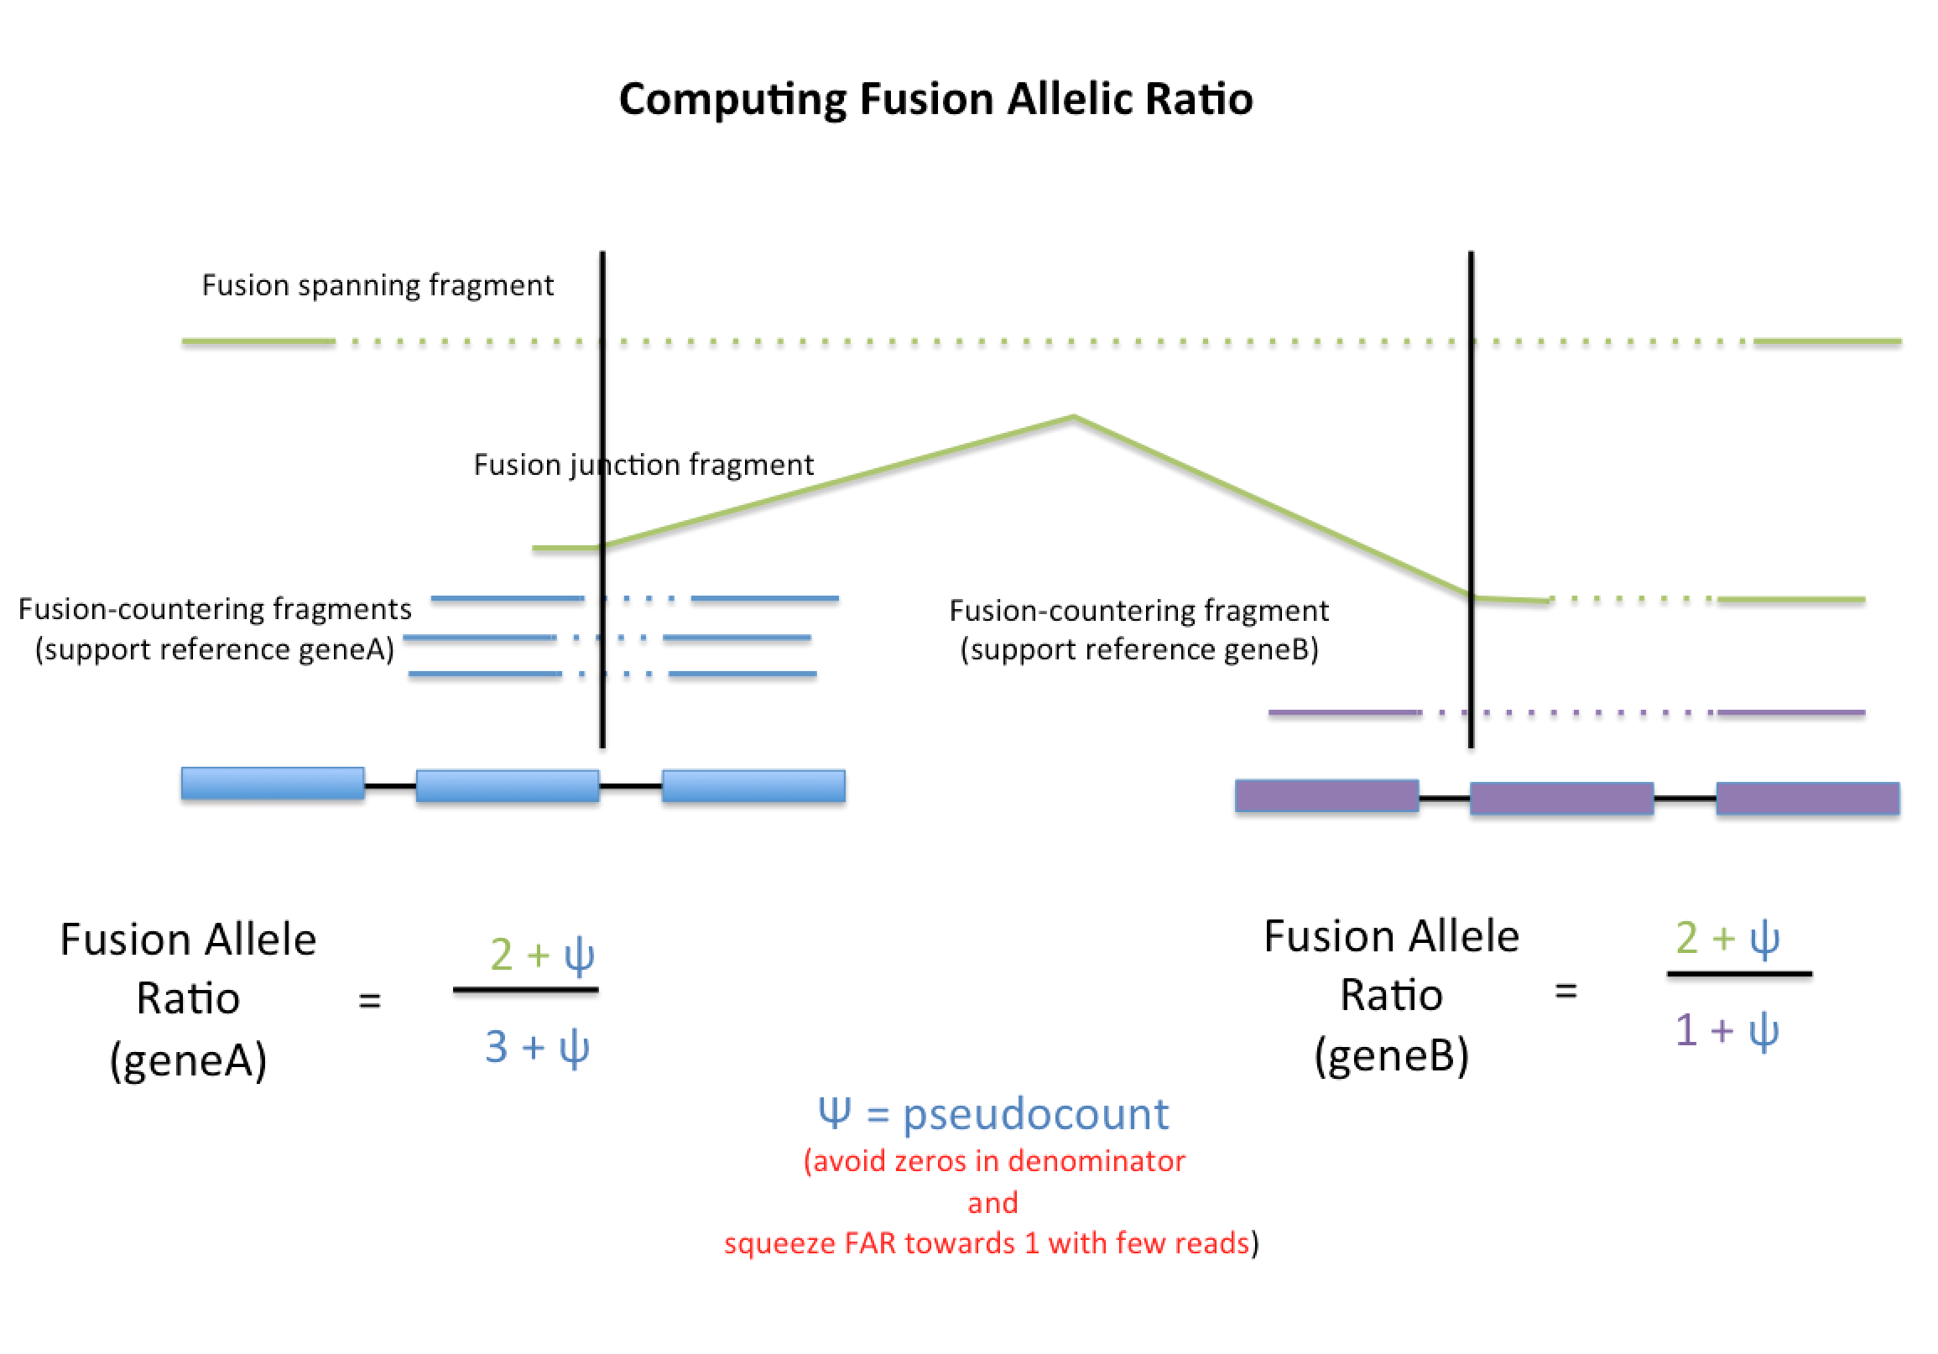
Fusion Allelic Ratio from FusionInspector
Insights into Fusion Expression vs. Non-Fused Allele

Slide 56
Reading Frame Preservation and 3’ Gene Function
Preserved reading frame results in at most one missense codon
Frame shift results in nonsense 3’ protein sequence
awm

Slide 57
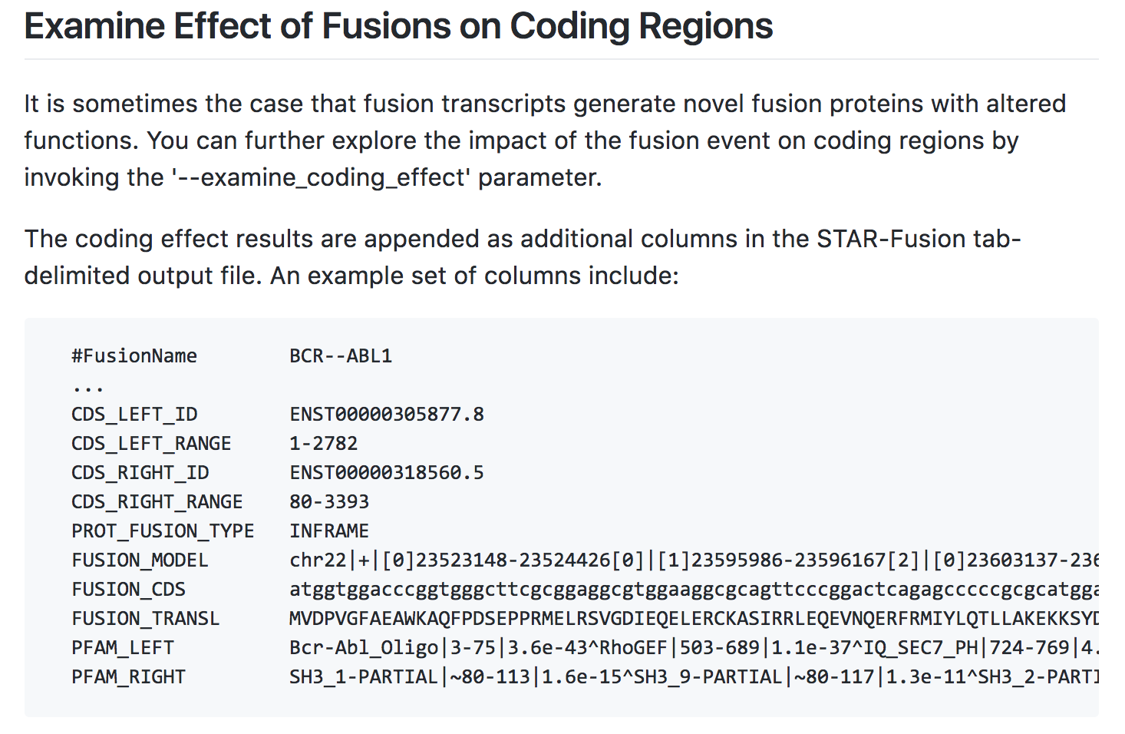
STAR-Fusion –examine_coding_effect

Slide 58

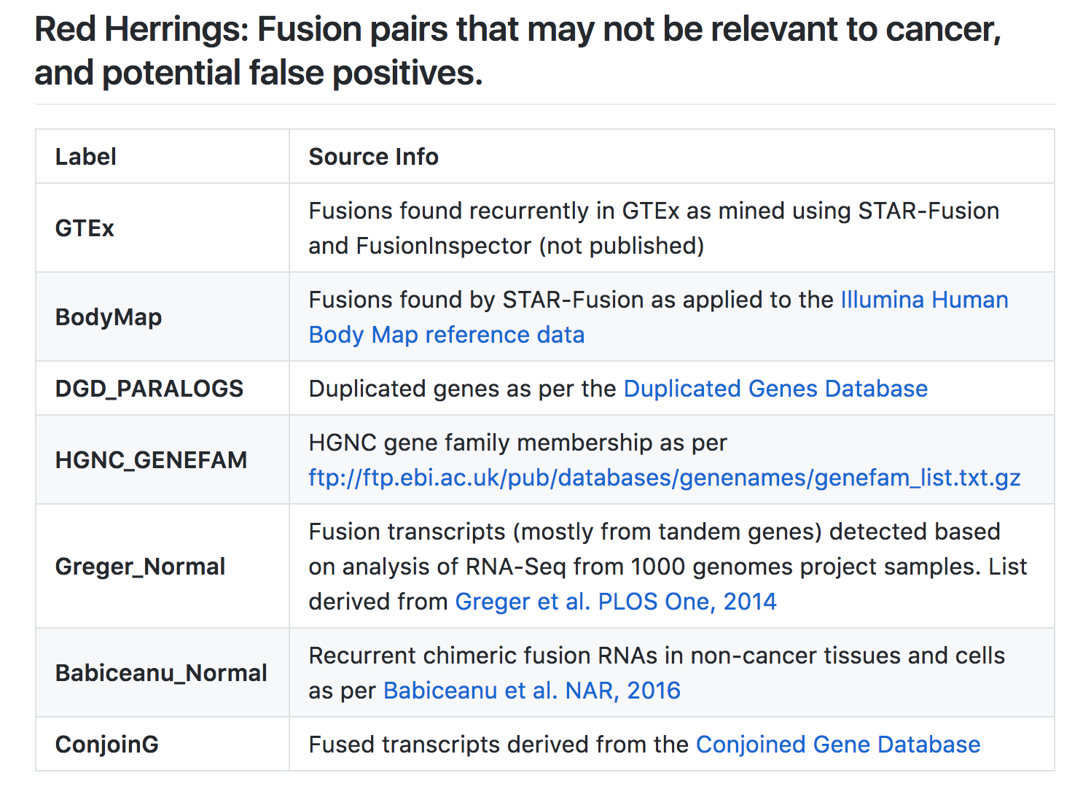
Beware of Red Herrings

Slide 59
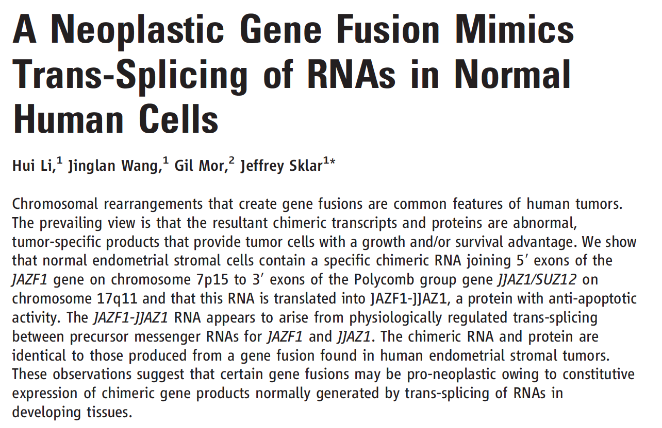
Caveats to Red Herrings
Why might BCR—ABL show up in GTEx?
(note, haven’t checked the very latest GTEx release yet… but it used to be there!)
Mimicry or ‘Normal’ fusions in certain contexts?
Li et al., Science 2008

Slide 60
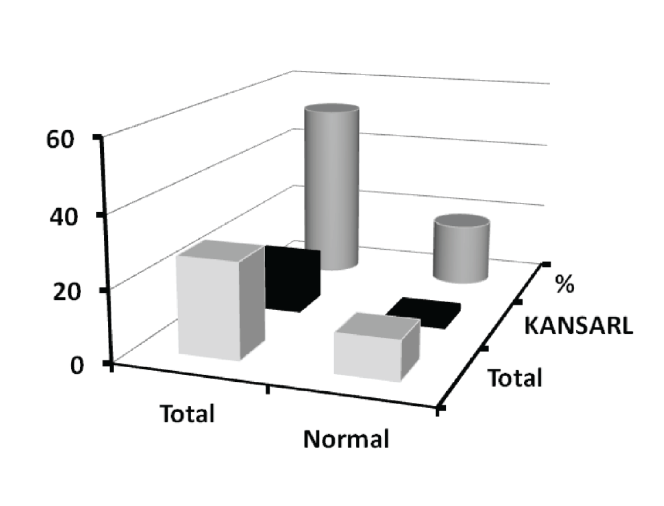
The semi-ubiquitous KANSL1-ARL17A fusion
Found in ~30% of those with European Ancestry
Statistically enriched in Glioma samples
m = matrix(c(14,13,15,2), byrow=T, ncol=2)
fisher.test(m)$p.value
P-value = 0.02
52%
Hmm….
What if there were 3 kansarl&normal instead of 2?
m = matrix(c(14,13,14,3), byrow=T, ncol=2)
fisher.test(m)$p.value
P-value = 0.06
12%
14
27
2
17
Glioma
I’m not convinced!
Let’s look at more samples…
Zhou et al., Oncotarget. 2017

Slide 61
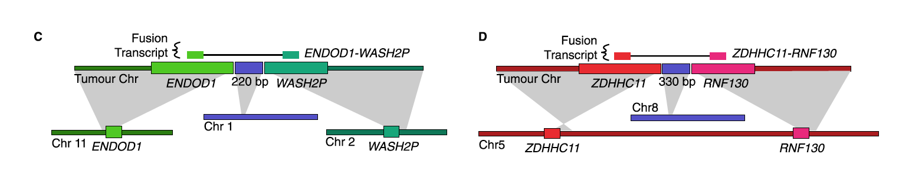
Genomic & Transcriptomic Data Maximize Insights into Cancer Fusions
Complex fusions revealed via breakpoint graphs:
Fusion Transcripts Inform the Biology
McPherson et al., 2012
awm

Slide 62
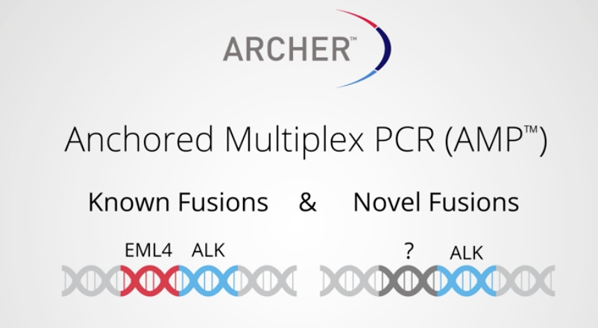
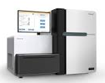
Experimental Design Considerations
Large cohort size
Prohibitive computational cost using some methods
Simpler method, filter recurrent artifacts
Fusion partners known
Consider targeted capture
How sensitive do you need to be?
How many millions of reads?
Long reads? Paired ends?
For example:
awm

Slide 63
Experimental Design Considerations
Artifacts are prevalent
Leverage multiple computational methods
Increased confidence for predictions nominated by multiple methods
Use orthogonal techniques (assembly / reference based)
Spot-check individual events
Manually check supporting reads
Always validate predictions
Validate a random sampling of each class of event for large sets of predictions
awm

Slide 64
Fusion Discovery and Analysis via Trinity CTAT
STAR-Fusion
RNA-Seq
Junction read
/1
/1
Chr-A
Spanning frag
/2
/2
Chr-B
In silico Validation of Fusion Prediction & Visualization
/2
/1
/2
De novo Reconstruction of Fusion Transcripts
FusionAnnotator
FusionCodingEffect
[Cosmic, Mitelman, ChimerPub, TCGA, …]
InFrame
DNA-binding ---- Kinase

Slide 65

Time for Fusion Lab

